Slide 1
Artificial Intelligence
Market Quotes

Slide 2
Mobile First -> AI First
Looking to the future, the next big step will be for the very concept of the “device” to fade away. Over time, the computer itself—whatever its form factor—will be an intelligent assistant helping you through your day. We will move from mobile first to an AI first world. – Sundar Pichai (Founders Letter, 2016)
Notes:
https://blog.google/topics/inside-google/this-years-founders-letter/
https://www.androidheadlines.com/2017/04/google-transitioning-ai-first-company-ceo-says.html

Slide 3
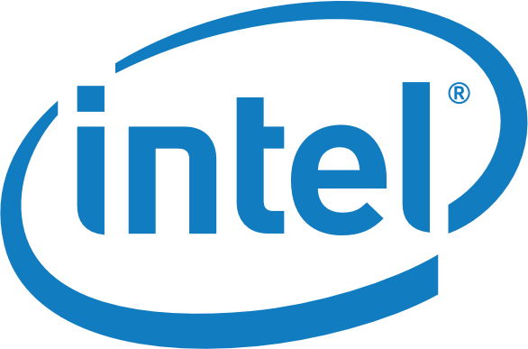
The Last Wave
“There's always a next wave,” Waxman said, noting that corporate computing has already gone from mainframes to client-server and now on to cloud computing. “I firmly believe this is not only the next wave but something that will dwarf the last wave.” – Intel Vice President on Nervana Acquisition a 48 person startup for $400 million, July 2016

Slide 4

Gartner
The world is becoming an intelligent, digitally enabled mesh of people, things and services. Ordinary people will experience a digitally enabled world where the lines between what's real and what's digital truly blur. AI and machine learning will be used to enhance analytics, actions and interfaces of nearly every technology-enabled system. New digital business models are emerging, and new ecosystems are forming to realign business and customer relationships.

Slide 5
Gartner Strategic Technology Trends - 2017
Notes:
http://www.gartner.com/smarterwithgartner/gartners-top-10-technology-trends-2017/

Slide 6

IDC – Cognitive/AI Market Share
Worldwide Cognitive Systems and Artificial Intelligence Revenues Forecast to Surge Past $47 Billion in 2020, According to New IDC Spending Guide.. cognitive/AI solutions will experience a compound annual growth rate (CAGR) of 55.1% over the 2016-2020 forecast period.
Notes:
http://www.businesswire.com/news/home/20161026005031/en/Worldwide-Cognitive-Systems-Artificial-Intelligence-Revenues-Forecast

